Slide 1
Azure AKS Kubernetes - Masterclass | DevOps, Microservices
Kalyan Reddy Daida

Slide 2
Kubernetes for Beginners On Cloud
STACKSIMPLIFY
AWS EKS Kubernetes - Masterclass | DevOps, Microservices
Kubernetes
On
Cloud
Roadmap
Azure AKS Kubernetes - Masterclass | DevOps, Terraform
Google GKE Kubernetes - Masterclass | DevOps, Microservices
Docker & Kubernetes for Java Spring Boot Developers on AWS

Slide 3

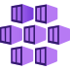
Azure AKS
Create Cluster
Introduction

Slide 4
AKS - Introduction
AKS – Azure Kubernetes Service
AKS is highly available, secure and fully managed Kubernetes Service
As on today available in 36 regions and growing.
When compared to other cloud providers, AKS is the one which is available in highest number of regions
Will be able to run any type of workloads
Windows based applications like .Net Apps
Linux supported applications like Java
IOT device deployment and management on demand
Machine Learning Model training with AKS

Slide 5
AKS Kubernetes - Architecture
Master
Worker Node -1
AKS Kube Controller Manager
Kubelet
Kube-Proxy
Container Runtime (Docker)
kube-apiserver
Worker Node - 2
etcd
kube-scheduler
Kubelet
Kube-Proxy
Container Runtime (Docker)
Container Runtime (Docker)
Azure AKS Cluster Control Plane
Azure AKS Node Pools

Slide 6
Kubernetes
Architecture

Slide 7
Kubernetes - Architecture
Master
Worker Node
Kube Controller Manager
Cloud Controller Manager
Kubelet
Kube-Proxy
Container Runtime (Docker)
kube-apiserver
Worker Node
etcd
kube-scheduler
Kubelet
Kube-Proxy
Container Runtime (Docker)
Container Runtime (Docker)

Slide 8
Kubernetes Architecture - Master
Master
kube-apiserver
It acts as front end for the Kubernetes control plane. It exposes the Kubernetes API
Command line tools (like kubectl), Users and even Master components (scheduler, controller manager, etcd) and Worker node components like (Kubelet) everything talk with API Server.
etcd
Consistent and highly-available key value store used as Kubernetes’ backing store for all cluster data.
It stores all the masters and worker node information.
kube-scheduler
Scheduler is responsible for distributing containers across multiple nodes.
It watches for newly created Pods with no assigned node, and selects a node for them to run on.
Kube Controller Manager
Cloud Controller Manager
kube-apiserver
etcd
kube-scheduler
Container Runtime (Docker)

Slide 9
Kubernetes Architecture - Master
Master
kube-controller-manager
Controllers are responsible for noticing and responding when nodes, containers or endpoints go down. They make decisions to bring up new containers in such cases.
Node Controller: Responsible for noticing and responding when nodes go down.
Replication Controller: Responsible for maintaining the correct number of pods for every replication controller object in the system.
Endpoints Controller: Populates the Endpoints object (that is, joins Services & Pods)
Service Account & Token Controller: Creates default accounts and API Access for new namespaces.
Kube Controller Manager
Cloud Controller Manager
kube-apiserver
etcd
kube-scheduler
Container Runtime (Docker)

Slide 10
Kubernetes Architecture - Master
Master
cloud-controller-manager
A Kubernetes control plane component that embeds cloud-specific control logic.
It only runs controllers that are specific to your cloud provider.
On-Premise Kubernetes clusters will not have this component.
Node controller: For checking the cloud provider to determine if a node has been deleted in the cloud after it stops responding
Route controller: For setting up routes in the underlying cloud infrastructure
Service controller: For creating, updating and deleting cloud provider load balancer
Kube Controller Manager
Cloud Controller Manager
kube-apiserver
etcd
kube-scheduler
Container Runtime (Docker)

Slide 11
Kubernetes Architecture – Worker Nodes
Worker Node
Kubelet
Kubelet is the agent that runs on every node in the cluster
This agent is responsible for making sure that containers are running in a Pod on a node.
Kube-Proxy
It is a network proxy that runs on each node in your cluster.
It maintains network rules on nodes
In short, these network rules allow network communication to your Pods from network sessions inside or outside of your cluster.
Kubelet
Kube-Proxy
Container Runtime (Docker)
Container Runtime
Container Runtime is the underlying software where we run all these Kubernetes components.
We are using Docker, but we have other runtime options like rkt, container-d etc.

Slide 12
Kubernetes - Architecture
Master
Worker Node
Kube Controller Manager
Cloud Controller Manager
Kubelet
Kube-Proxy
Container Runtime (Docker)
kube-apiserver
Worker Node
etcd
kube-scheduler
Kubelet
Kube-Proxy
Container Runtime (Docker)
Container Runtime (Docker)

Slide 13
Kubernetes
Fundamentals
Pod, ReplicaSet, Deployment & Service

Slide 14
Kubernetes - Fundamentals
Pod
A POD is a single instance of an Application.
A POD is the smallest object, that you can create in Kubernetes.
ReplicaSet
A ReplicaSet will maintain a stable set of replica Pods running at any given time.
In short, it is often used to guarantee the availability of a specified number of identical Pods
k8s Fundamentals
Deployment
A Deployment runs multiple replicas of your application and automatically replaces any instances that fail or become unresponsive.
Rollout & rollback changes to applications. Deployments are well-suited for stateless applications.
Service
A service is an abstraction for pods, providing a stable, so called virtual IP (VIP) address.
In simple terms, service sits Infront of a POD and acts as a load balancer.

Slide 15
Kubernetes - Imperative & Declarative
Kubernetes Fundamentals
Imperative
Declarative
kubectl
YAML & kubectl
Pod
Pod
ReplicaSet
ReplicaSet
Deployment
Deployment
Service
Service

Slide 16
Kubernetes
POD

Slide 17
Kubernetes - POD
With Kubernetes our core goal will be to deploy our applications in the form of containers on worker nodes in a k8s cluster.
Kubernetes does not deploy containers directly on the worker nodes.
Container is encapsulated in to a Kubernetes Object named POD.
A POD is a single instance of an application.
A POD is the smallest object that we can create in Kubernetes.
N
Nginx Container
Image
N
N
POD
POD
Worker Node
Worker Node
Node
Worker Node
Kubernetes Cluster

Slide 18

Kubernetes - POD
PODs generally have one to one relationship with containers.
To scale up we create new POD and to scale down we delete the POD.
N
N
N
N
POD
POD
POD
POD
Worker Node - 1
Worker Node - 2
Kubernetes Cluster

Slide 19
Kubernetes – PODs
We cannot have multiple containers of same kind in a single POD.
Example: Two NGINX containers in single POD serving same purpose is not recommended.
N
N
N
N
N
POD
POD
POD
POD
Worker Node - 1
Worker Node - 2
Kubernetes Cluster

Slide 20
Kubernetes – Multi-Container Pods
We can have multiple containers in a single POD, provided they are not of same kind.
Helper Containers (Side-car)
Data Pullers: Pull data required by Main Container
Data pushers: Push data by collecting from main container (logs)
Proxies: Writes static data to html files using Helper container and Reads using Main Container.
Communication
The two containers can easily communicate with each other easily as they share same network space.
They can also easily share same storage space.
Multi-Container Pods is a rare use-case and we will try to focus on core fundamentals.
N
H
POD
Worker Node
Kubernetes Cluster
Helper
Containers
Node

Slide 21
Kubernetes
PODs
Demo

Slide 22
Kubernetes
Services - NodePort

Slide 23

Kubernetes – Service - NodePort
We can expose an application running on a set of PODs using different types of Services available in k8s.
ClusterIP
NodePort
LoadBalancer
NodePort Service
To access our application outside of k8s cluster, we can use NodePort service.
Exposes the Service on each Worker Node's IP at a static port (nothing but NodePort).
A ClusterIP Service, to which the NodePort Service routes, is automatically created.
Port Range 30000-32767
http://<Worker-Node-IP>:<NodePort>
NodePort: 3xxx
User
Worker NodePort
Port: 80
Service
ClusterIP Service Port
targetPort: 80
Container Port in a POD
Node
N
POD
Worker Node
Worker Node
Worker Node
Node
Kubernetes Cluster

Slide 24
Kubernetes
POD & NodePort Service
Demo

Slide 25
Kubernetes
ReplicaSets

Slide 26
Kubernetes - ReplicaSets
High Availability or Reliability
Scaling
ReplicaSets
Load Balancing
Labels & Selectors

Slide 27
Kubernetes – ReplicaSet
A ReplicaSet’s purpose is to maintain a stable set of replica Pods running at any given time.
If our application crashes (any pod dies), replicaset will recreate the pod immediately to ensure the configured number of pods running at any given time.
Reliability
Or
High Availability
N
N
N
POD
POD
POD
ReplicaSet
Worker Node
Kubernetes Cluster

Slide 28

Kubernetes – ReplicaSet
Load Balancing
To avoid overloading of traffic to single pod we can use load balancing.
Kubernetes provides pod load balancing out of the box using Services for the pods which are part of a ReplicaSet
Labels & Selectors are the key items which ties all 3 together (Pod, ReplicaSet & Service), we will know in detail when we are writing YAML manifests for these objects
Service
N
N
N
N
POD
POD
POD
POD
ReplicaSet
Worker Node
Worker Node
Kubernetes Cluster

Slide 29
Kubernetes – ReplicaSet
Scaling
When load become too much for the number of existing pods, Kubernetes enables us to easily scale up our application, adding additional pods as needed.
This is going to be seamless and super quick.
Service
N
N
N
N
POD
POD
POD
POD
ReplicaSet
Worker Node
Worker Node
Kubernetes Cluster

Slide 30
Kubernetes
ReplicaSets
Demo

Slide 31
Kubernetes
Deployments

Slide 32
Kubernetes – Deployments
Service
N
N
N
N
POD
POD
POD
POD
ReplicaSet
Deployment
Worker Node - 1
Worker Node - 2
Kubernetes Cluster

Slide 33
Kubernetes - Deployment
Create a Deployment to rollout a ReplicaSet
Updating the Deployment
Rolling Back a Deployment
Deployments
Scaling a Deployment
Pausing and Resuming a Deployment
Deployment Status
Clean up Policy
Canary Deployments

Slide 34
Kubernetes
Deployments
Demo

Slide 35
Kubernetes
Services

Slide 36
Kubernetes - Services
ClusterIP
Used for communication between applications inside k8s cluster (Example: Frontend application accessing backend application)
NodePort
Used for accessing applications outside of of k8s cluster using Worker Node Ports (Example: Accessing Frontend application on browser)
Services
LoadBalancer
Primarily for Cloud Providers to integrate with their Load Balancer services (Example: AWS Elastic Load Balancer)
Ingress
Ingress is an advanced load balancer which provides Context path based routing, SSL, SSL Redirect and many more (Example: AWS ALB)
externalName
To access externally hosted apps in k8s cluster (Example: Access AWS RDS Database endpoint by application present inside k8s cluster)

Slide 37


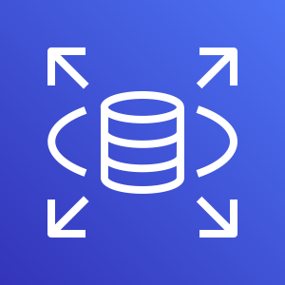
Services
Kubernetes Cluster
Frontend App – NodePort or LoadBalancer or Ingress Service
Users
N
N
N
POD
POD
POD
ReplicaSet
Deployment (app=frontend)
Backend App - ClusterIP Service
AWS Cloud
B
B
B
DB – ExternalName Service
POD
POD
POD
AWS RDS Database
ReplicaSet
Deployment (app=Backend)

Slide 38
Kubernetes
Services
Demo

Slide 39
Services Demo
Kubernetes Cluster
Frontend App – NodePort Service
Users
http://<workernode-public-ip>:<NodePort>/hello
N
POD
ReplicaSet
Deployment (app=frontend)
Backend App - ClusterIP Service
B
POD
ReplicaSet
Deployment (app=Backend)

Slide 40
Kubernetes
YAML Basics

Slide 41
YAML Basics
YAML is not a Markup Language
YAML is used to store information about different things
We can use YAML to define key, Value pairs like variables, lists and objects
YAML is very similar to JSON (Javascript Object Notation)
YAML primarily focuses on readability and user friendliness
YAML is designed to be clean and easy to read
We can define YAML files with two different extensions
abc.yml
abc.yaml

Slide 42
YAML Basics
YAML Comments
YAML Key Value Pairs
YAML Dictionary or Map
YAML Array / Lists
YAML Spaces
YAML Document Separator

Slide 43


Azure AKS Storage
with
Azure Disks & Files

Slide 44
AKS Storage Concepts
Storage Concepts
Volumes (K8S)
Persistent Volumes
Storage Classes
Persistent Volume Claims
emptyDir
Azure Disks
default
Dynamically provision the storage
secret
Azure Files
managed-premium
configMap
azurefile
azurefile-premium

Slide 45

Why do we need Persistent Storage in Kubernetes?
Volumes that are defined and created as part of the pod lifecycle only exist until the pod is deleted.
Pods often expect their storage to remain if a pod is rescheduled on a different host during a maintenance event, especially in StatefulSets.
A persistent volume (PV) is a storage resource created and managed by the Kubernetes API that can exist beyond the lifetime of an individual pod.
For AKS, Azure Disks or Azure Files are used to provide the PersistentVolume.
Azure AKS Cluster
Persistent Volume
(Static / Dynamic)
Single Node / Pod Access
Azure Managed Disks
Azure Files
Multiple Concurrent Node / Pod Access
Azure Storage Account

Slide 46
Persistent Volume Claims – How it works?
PVC will request storage based on specifics from Storage class (Disk or File)
Kube API Server will dynamically provision the Persistent Volume PV requested
Once the PV is available it will get mounted to Pod for usage.
create a pod
Azure AKS Cluster
Storage Class
Azure Managed Disks
Premium / Standard
Storage
POD
Persistent Volume Claim
Persistent Volume
Mount the Volume to Pod
Worker Node
Azure Files
(Standard Storage)
Storage Account

Slide 47
Azure AKS Storage
with
Azure Disks

Slide 48
Azure Disks - Introduction
Azure Disk Storage offers high-performance, highly durable block storage for our mission- and business-critical workloads
We can mount these volumes as devices on our Virtual Machines & Container instances.
Cost-effective storage
Built-in bursting capabilities to handle unexpected traffic and process batch jobs cost-effectively
Unmatched resiliency
0 percent annual failure rate for consistent enterprise-grade durability
Seamless scalability
Dynamic scaling of disk performance on Ultra Disk Storage without disruption
Built-in security
Automatic encryption to help protect your data using Microsoft-managed keys or your own

Slide 49
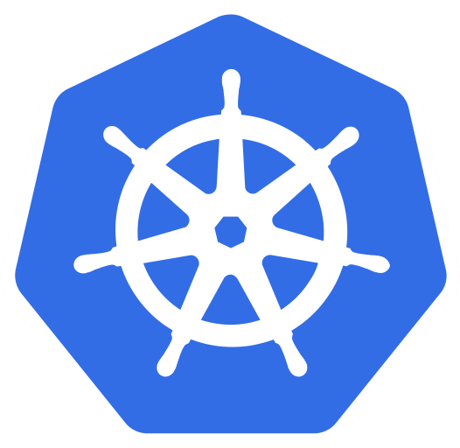
AKS Storage Azure Disks
Azure AKS Cluster
Azure Disks
MySQL – ClusterIP Service
Config Map
Storage Class
Environment Variables
Persistent Volume Claim
Volumes
MySql
Persistent Volumes
Volume Mounts
POD
ReplicaSet
Deployment
Deployment (mysql)
ClusterIP Service

Slide 50
Azure AKS Cluster
http://<External-IP-from-get-service-output>
UserMgmt – LoadBalancer Service
Users
Load Balancer Service
Deployment
Web
App
Environment Variables
POD
ReplicaSet
Init Containers
Azure Disks
Deployment (UserMgmt)
MySQL – ClusterIP Service
Config Map
Storage Class
Environment Variables
Persistent Volume Claim
Volumes
MySql
AKS Storage Azure Disks
Persistent Volumes
Volume Mounts
POD
ReplicaSet
Deployment
Deployment (mysql)
ClusterIP Service

Slide 51

Azure AKS Storage
with
Azure MySQL Database

Slide 52
Azure AKS Cluster
http://<External-IP-from-get-service-output>
UserMgmt – LoadBalancer Service
Users
Load Balancer Service
AKS Storage Azure MySQL
Database
Deployment
Web
App
Environment Variables
POD
ReplicaSet
Init Containers
Drawbacks of Azure Disks
Azure Disks
Deployment (UserMgmt)
Complex setup to achieve HA, Statefulsets
MySQL – ClusterIP Service
Config Map
Complex Master-Master MySQL setup
Storage Class
Environment Variables
Complex Master-Slave MySQL setup
Persistent Volume Claim
Volumes
No Automatic Backup & Recovery
MySql
No Auto-Upgrade MySQL
Persistent Volumes
Volume Mounts
POD
Logging, Monitoring needs custom sctipts
ReplicaSet
Deployment
Deployment (mysql)
ClusterIP Service

Slide 53
Azure MySQL Database
Features
Built-in high availability with no additional cost.
Predictable performance, using inclusive pay-as-you-go pricing.
Scale as needed within seconds.
Secured to protect sensitive data at-rest and in-motion.
Automatic backups and point-in-time-restore for up to 35 days.
Enterprise-grade security and compliance.

Slide 54
Azure AKS Cluster
http://<External-IP-from-get-service-output>
UserMgmt – LoadBalancer Service
Users
Load Balancer Service
Deployment
Web
App
Environment Variables
POD
ReplicaSet
Init Containers
Deployment (UserMgmt)
MySQL – ExternalName Service
High Availability
Monitoring & Alerting
AKS Storage Azure MySQL Database
Backup & Recovery
Automatic Upgrades
Read Replicas
Azure MySQL
Database
Secure Data at rest and motion

Slide 55
Azure AKS Storage
with
Azure Files

Slide 56
Azure Files
These are simple, secure and fully managed cloud file shares
We can secure data at rest and in-transit using SMB 3.0 and HTTPS
We can create high-performance file shares using the Premium Files storage tier
We can replace or supplement on-premises file servers
Scripting and tooling: PowerShell cmdlets and Azure CLI can be used to create, mount, and manage Azure file shares as part of the administration of Azure applications.
We can create and manage Azure file shares using Azure portal and Azure Storage Explorer.
For Application workloads we can use for use cases like Static Content storage, shared configuration access to multiple JVMs etc.

Slide 57
http://<External-IP-from-get-service-output>/app1/file1.html
Azure AKS Cluster
LoadBalancer Service
Users
Load Balancer Service
AKS Storage Azure Files
Deployment
NGINX
NGINX
NGINX
POD
POD
POD
Volumes
ReplicaSet
Deployment
Volume Mounts
Storage Class
Key Advantage with Azure File Shares:
Multiple pods can access the single file share
Azure Storage Account
Persistent Volume Claim
file1.html
file2.html
Persistent Volumes
</>
HTML
</>
HTML
Azure File Shares

Slide 58
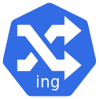
Azure AKS
Ingress

Slide 59

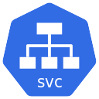




Why do we need Ingress?
Azure
AKS
type: LoadBalancer
Public IP-1
Service: App1
App1
Service: App2
App2
Public IP-2
AKS
Load Balancer
No SSL Termination
Public IP-3
Service: App3
App3
We have 3 public Ips for 3 apps – Not good
In simple terms, native Kubernetes services cannot do all the reverse proxy magic and we need something else in k8s do and there comes ingress

Slide 60
What is Ingress?
Ingress is a Kubernetes resource that lets us configure an HTTP load balancer for applications running on Kubernetes, with advanced capabilities at HTTP layer.
Context Path based Routing
Ingress
Features
Host based Routing
TLS / SSL Termination

Slide 61
Ingress - Terminology
Ingress Controller
Ingress Resource or Service
Ingress controller is an application that runs in a cluster and configures an HTTP load balancer according to Ingress resources.
Equivalent to Kubernetes Services but with lot of additional features
The load balancer can be a software load balancer running in the cluster or a hardware or cloud load balancer running externally.
We can define routing rules based on URI or Hostname in Ingress Resource Manifest
In the case of NGINX, the Ingress controller is deployed in a pod along with the load balancer.
We can even define SSL / TLS related information in Ingress Resource Manifest

Slide 62
Azure AKS & Nginx Ingress – Context Path Based Routing
Azure
Azure AKS Cluster
Nginx App1
/app1/
/app2/
/
Ingress Service
Nginx App2
Users
Public IP
for Ingress
Controller
Ingress Controller
AKS
Load Balancer
Usermgmt WebApp

Slide 63

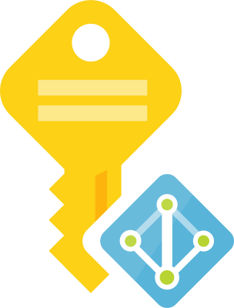

Azure AKS Nginx Ingress External DNS
Azure
Azure AKS Cluster
Virtual Machine
Scale Sets
DNS
Zones
Managed
Service
Identity
Nginx App1
External DNS
eapp1.kubeoncloud.com
eapp2.kubeoncloud.com
eapp3.kubeoncloud.com
Nginx App2
Ingress Service
Users
Public IP
for Ingress
Controller
Ingress Controller
AKS
Load Balancer
Usermgmt WebApp

Slide 64

Azure AKS Nginx Ingress External DNS SSL with Lets Encrypt
Azure
Azure AKS Cluster
Virtual Machine
Scale Sets
External DNS
DNS
Zones
Managed
Service
Identity
cert-manager
sapp1.kubeoncloud.com
sapp2.kubeoncloud.com
Nginx App1
Ingress Service
Users
Public IP
for Ingress
Controller
Ingress Controller
AKS
Load Balancer
Nginx App2

Slide 65
Nginx Ingress Controller - References
List of Ingress Controllers
https://kubernetes.io/docs/concepts/services-networking/ingress-controllers/
Azure AGIC (Application Gateway Ingress Controller)
https://github.com/Azure/application-gateway-kubernetes-ingress
https://azure.microsoft.com/en-in/pricing/details/application-gateway/

Slide 66
Azure AKS
Nginx Ingress Service
Install & Implement

Slide 67
Azure AKS & Nginx Ingress – Basic Architecture
Azure
Azure AKS Cluster
Nginx App1
/
Ingress Service
Users
Public IP
for Ingress
Controller
Ingress Controller
AKS
Load Balancer

Slide 68
Azure AKS
Nginx Ingress Service
Context Path based Routing

Slide 69
Azure AKS & Nginx Ingress – Context Path Based Routing
Azure
Azure AKS Cluster
Nginx App1
/app1/
/app2/
/
Ingress Service
Nginx App2
Users
Public IP
for Ingress
Controller
Ingress Controller
AKS
Load Balancer
Usermgmt WebApp

Slide 70
DNS
Zones
Managed
Service
Identity
Azure AKS
Nginx Ingress Service
External DNS

Slide 71
Azure AKS Nginx Ingress External DNS
Azure
Azure AKS Cluster
Virtual Machine
Scale Sets
DNS
Zones
Managed
Service
Identity
Nginx App1
External DNS
eapp1.kubeoncloud.com
Ingress Service
eapp1.kubeoncloud.com
Users
Public IP
for Ingress
Controller
Ingress Controller
AKS
Load Balancer

Slide 72
DNS
Zones
Managed
Service
Identity
Azure AKS
Nginx Ingress Service
Hostname based Routing

Slide 73



Azure AKS Nginx Ingress External DNS Hostname based Routing
Azure
Azure AKS Cluster
Virtual Machine
Scale Sets
DNS
Zones
Managed
Service
Identity
Nginx App1
External DNS
eapp1.kubeoncloud.com
eapp2.kubeoncloud.com
Users
eapp1.kubeoncloud.com
eapp3.kubeoncloud.com
Nginx App2
Ingress Service
eapp2.kubeoncloud.com
Public IP
for Ingress
Controller
Ingress Controller
AKS
Load Balancer
Usermgmt WebApp
eapp3.kubeoncloud.com

Slide 74
DNS
Zones
Managed
Service
Identity
Azure AKS
Nginx Ingress Service
Ingress SSL
Automatically generate and renew ssl certificates

Slide 75
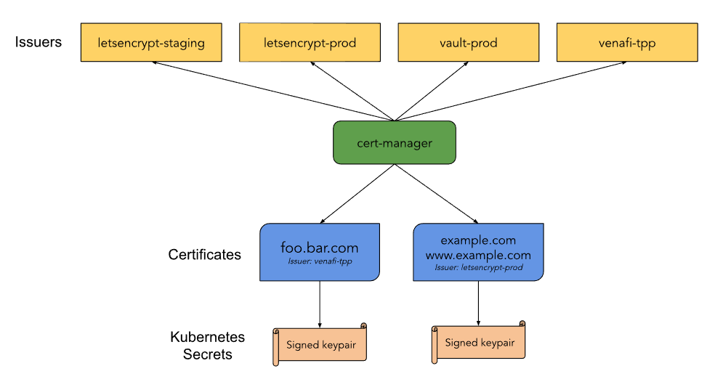
Kubernetes cert-manager

Slide 76
Azure AKS Nginx Ingress External DNS SSL with Lets Encrypt
Azure
Azure AKS Cluster
Virtual Machine
Scale Sets
External DNS
DNS
Zones
Managed
Service
Identity
5 mins to 1 hour
cert-manager
sapp1.kubeoncloud.com
sapp2.kubeoncloud.com
https://sapp1.kubeoncloud.com/app1/index.html
Nginx App1
https://sapp2.kubeoncloud.com/app2/index.html
Ingress Service
HTTPS
Users
Public IP
for Ingress
Controller
Ingress Controller
AKS
Load Balancer
Nginx App2

Slide 77
BLANK SLIDE

Slide 78
Which Ingress Controller to Use?
Nginx Ingress Controller (Open Source)
Azure Application Gateway Ingress Controller (AGIC)
Free of cost, only uses AKS memory and cpu resources
Very costly and still uses AKS memory and cpu resources
Stable and very very good open source community support.
Recently launched and most of the features are in preview mode.
Good for smaller workloads and smaller deployment foot print
Good for large scale workloads, at the same time who can afford the price

Slide 79

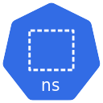

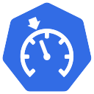



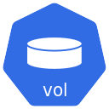
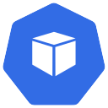
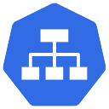




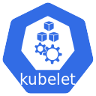
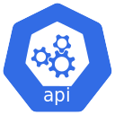

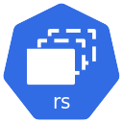
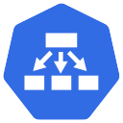
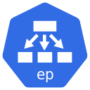
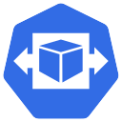
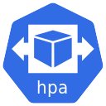


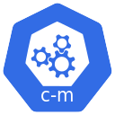



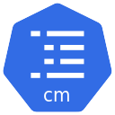

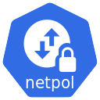

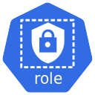
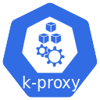
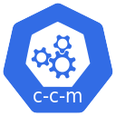

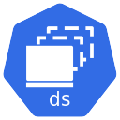


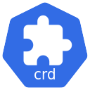

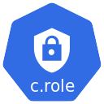



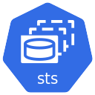

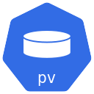

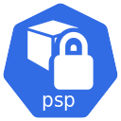

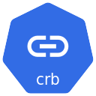
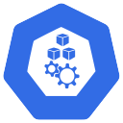
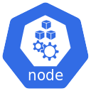



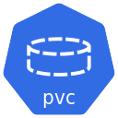
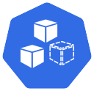
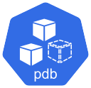

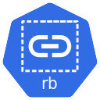


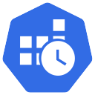


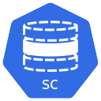

Slide 80

AWS EKS Storage
Application Deployment
Concepts

Slide 81
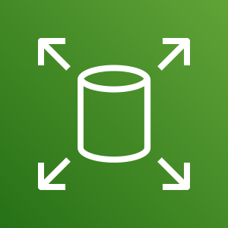
EKS Cluster
http://<workernode-public-ip>:<NodePort>/usermgmt/<apis>
UserMgmt – NodePort Service
Secrets
Namespaces
Users
Init Containers
NodePort Service
Liveness & Readiness Probes
REST API
Deployment
EKS Storage EBS CSI Driver
Requests & Limits
POD
Environment Variables
ReplicaSet
Deployment (UserMgmt)
MySQL – ClusterIP Service
AWS Elastic Block Store - EBS
Storage Class
Environment Variables
Persistent Volume Claim
Volumes
MySql
Config Map
Volume Mounts
POD
ReplicaSet
Deployment
Deployment (mysql)
ClusterIP Service

Slide 82
Probes
Probes
Liveness Probe
Readiness Probe
Startup Probe
Kubelet uses liveness probes to know when to restart a container
Kubelet uses readiness probes to know when a container is ready to accept traffic
Kubelet uses startup probes to know when a container application has started
Liveness probes could catch a deadlock, where an application is running, but unable to make progress and restarting container helps in such state
When a Pod is not ready, it is removed from Service load balancers based on this readiness probe signal.
Firstly this proble disables liveness & readiness checks until it succeeds ensuring those pods don’t interfere with app startup.
This can be used to adopt liveness checks on slow starting containers, avoiding them getting killed by the kubelet before they are up and running.
Options to define Probes
Check using Commands
/bin/sh –c nc -z localhost 8095
Check using HTTP GET Request
httpget path:/health-status
Check using TCP
tcpSocket Port: 8095

Slide 84
Backup Slides

Slide 86
Kubernetes Concepts
AWS Services Integration with EKS
DevOps
Microservices

Slide 87


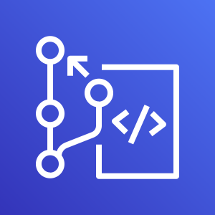

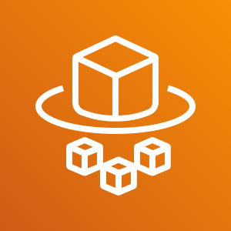

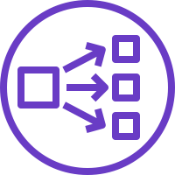
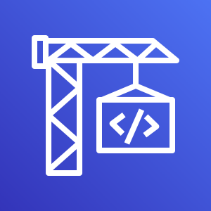







Architecture
kubectl - Imperative
Persistent Volumes
K
U
B
E
R
N
E
T
E
S
A
W
S
S
E
R
V
I
C
E
S
Pods
Declarative with YAML
PVC
ReplicaSets
Secrets
Load Balancers
Deployments
Init Containers
Annotations
Node Port Service
Probes
Canary Deployments
Cluster IP Service
Requests & Limits
HPA
External Name Service
Namespaces
VPA
Ingress Service
Limit Range
DaemonSets
Ingress SSL
Resource Quota
Fluentd for logs
Ingress & External DNS
Storage Classes
ConfigMaps
DevOps
Microservices
AWS Developer Tools
Service Discovery
Distributed Tracing
Canary Deployments
AWS CodeCommit
AWS CodeBuild
AWS CodePipeline

Slide 88
Docker - Fundamentals
nginxdemos/hello
Docker Daemon
Docker Registry
(Docker Hub)
nginxdemos/hello
Container-11
Images
Containers
Docker Host
docker pull nginxdemos/hello
Docker Registry or Docker Hub
A Docker registry stores Docker images.
Docker Hub is a public registry that anyone can use, and Docker is configured to look for images on Docker Hub by default.
We can even run our own private registry.
When we use the docker pull or docker run commands, the required images are pulled from our configured registry.
When we use the docker push command, our image is pushed to our configured registry.
docker run -p 82:80 -d nginxdemos/hello
Docker Client (My Desktop or Docker Host)

Slide 89
Kubernetes - Imperative & Declarative
Kubernetes Fundamentals
Imperative
Declarative
kubectl
YAML & kubectl
Pod
Pod
ReplicaSet
ReplicaSet
Deployment
Deployment
Service
Service

Slide 90
EKS Cluster
http://<workernode-public-ip>:<NodePort>/usermgmt/<apis>
UserMgmt – NodePort Service
Users
NodePort Service
EKS Storage EBS CSI Driver
REST API
Deployment
POD
Environment Variables
ReplicaSet
Drawbacks of EBS CSI for MySQL DB
Deployment (UserMgmt)
Complex setup to achieve HA
MySQL – ClusterIP Service
StatefulSets
AWS Elastic Block Store - EBS
Complex Multi-Az support for EBS
Storage Class
Environment Variables
Complex Master-Master MySQL setup
Persistent Volume Claim
Volumes
Complex Master-Slave MySQL setup
MySql
No Automatic Backup & Recovery
Config Map
Volume Mounts
POD
No Auto-Upgrade MySQL
ReplicaSet
Deployment
Deployment (mysql)
ClusterIP Service

Slide 91
http://<workernode-public-ip>:<NodePort>/usermgmt/<apis>
EKS Cluster
UserMgmt – NodePort Service
Users
NoePort Service
REST API
Deployment
AWS
RDS Database
POD
Environment Variables
ReplicaSet
Deployment (UserMgmt)
ExternalName Service
MySQL – ExternalName Service
High Availability
Metrics & Monitoring
Backup & Recovery
Automatic Upgrades
Read Replicas
Amazon RDS
Multi-AZ Support

Slide 92




AWS Cloud
EKS Cluster Control Plane
VPC
Availability Zone: us-east-1a
Availability Zone: us-east-1b
Public subnet
Public subnet
http://<workernode-public-ip>:<NodePort>/usermgmt/<apis>
EC2 Worker Node-1
EC2 Worker Node-2
User Management – Node Port Service
Users
U
U
ReplicaSet
U
U
Pod
Pod
Pod
Pod
Deployment
MySQL – External Name Service
Private subnet
Private subnet
AWS EKS
Network Design
With
EKS Workload
&
RDS Database
Amazon RDS
Amazon RDS

Slide 93

AWS Cloud
VPC
EKS Cluster Control Plane
Availability Zone: us-east-1a
Availability Zone: us-east-1b
Users
Public subnet
Public subnet
Classic CLB DNS URL
Classic Load Balancer
User Management – Classic Load Balancer Service
NAT gateway
NAT gateway
Private subnet
Private subnet
EC2 Worker Node-1
EC2 Worker Node-2
U
U
ReplicaSet
U
U
Pod
Pod
Pod
Pod
Deployment
MySQL – External Name Service
AWS EKS
Network Design
With
EKS Workload
RDS & ELB
Classic Load Balancer
EKS Private NodeGroup
Amazon RDS DB
Amazon RDS DB

Slide 94
AWS Cloud
VPC
EKS Cluster Control Plane
Availability Zone: us-east-1a
Availability Zone: us-east-1b
Users
Public subnet
Public subnet
NLB DNS URL
Network Load Balancer
User Management – Network Load Balancer Service
NAT gateway
NAT gateway
Private subnet
Private subnet
EC2 Worker Node-1
EC2 Worker Node-2
U
U
ReplicaSet
U
U
Pod
Pod
Pod
Pod
Deployment
MySQL – External Name Service
AWS EKS
Network Design
With
EKS Workload
RDS & ELB
Network Load Balancer
EKS Private NodeGroup
Amazon RDS DB
Amazon RDS DB

Slide 95
AWS Cloud
VPC
EKS Cluster Control Plane
Availability Zone: us-east-1a
Availability Zone: us-east-1b
Users
Amazon Route 53
Public subnet
Public subnet
SSL
Application Load Balancer
HTTP → HTTPS
SSL Redirect
external-dns
User Management – Application Load Balancer Service (Ingress)
apps.kubeoncloud.com
NAT gateway
NAT gateway
/app1/*
/app2/*
Ingress
/*
HTTPS URLS
https://apps.kubeoncloud.com/usermgmt/users
Private subnet
Private subnet
EC2 Worker Node-1
EC2 Worker Node-2
app1- NodePort SVC
app2 -NodePort SVC
User Management – Node Port Service
N
N
U
AWS Certificate Manager
Pod
Pod
Pod
ReplicaSet
ReplicaSet
ReplicaSet
Deployment: app1
Deployment: app2
Deployment: UMS
MySQL – External Name Service
AWS EKS
Network Design
With
EKS Workload
RDS & ELB
Application
Load Balancer & Route53
Ingress & External-DNS
EKS Private NodeGroup
Amazon RDS DB
Amazon RDS DB

Slide 96


EKS Deployment Options - Mixed
EKS Cluster
AWS Cloud
VPC
Availability Zone: us-east-1a
Availability Zone: us-east-1b
Availability Zone: us-east-1a
Availability Zone: us-east-1b
Public subnet
Public subnet
Public subnet
Public subnet
Auto Scaling group
EC2 Instance
EKS Public Managed Node Group
EC 2Instance
Private subnet
Private subnet
Private subnet
EKS Fargate
Private subnet
Auto Scaling group
Fargate Profile
EC2 Instance
EKS Private Managed Node Group
EC 2Instance
Fargate EC2 Instance
Fargate EC2 Instance
EKS Managed Node Groups
EKS Fargate Profiles

Slide 97
EKS Deployment Options – Mixed Mode - 3 Apps
Users
AWS Cloud
app1. kubeoncloud.com
app2.kubeoncloud.com
ums.kubeoncloud,com
Amazon RDS DB
app1.kubeoncloud.com
app2.kubeoncloud.com
ums.kubeoncloud.com
Amazon Route 53
VPC
Availability Zone: us-east-1a
Availability Zone: us-east-1b
Availability Zone: us-east-1a
EKS Fargate
Availability Zone: us-east-1b
Public subnet
Public subnet
Private subnet
Private subnet
App1 - Ingress
UMS - Ingress
NS: ns-ums
MySQL – ExternalName Service
Fargate Profile: UMS
Ingress
App2 - Ingress
U
U
UMS Pod
UMS Pod
Private subnet
Private subnet
UMS - NodePort Service
NS: ns-app1
App1 - NodePort Service
NS: ns-app2
App2 - NodePort Service
Auto Scaling group
Fargate Profile: App2
N
N
N
N
App1 Pod
EKS Private Managed Node Group
App1 Pod
App2 Pod
App2 Pod
EKS Managed Node Groups
EKS Fargate Profiles
AWS Certificate Manager
EKS Cluster

Slide 98


EKS & ECR
Developer
Users
http://ecrdemo.kubeoncloud.com
AWS Cloud
ecrdemo.kubeoncloud.com
Push Images
EKS Cluster
Amazon Route 53
AWS Certificate Manager
VPC
Docker Image
Pull Docker Image from ECR
Availability Zone: us-east-1a
Availability Zone: us-east-1b
Public subnet
Public subnet
Ingress
Elastic Container Registry - ECR
NAT gateway
ECR Demo - ALB Ingress Service
NAT gateway
Private subnet
Private subnet
EC2 Worker Node-1
EC2 Worker Node-2
ECR Demo App - NodePort Service
N
N
Pod
Pod
EKS Private Managed Node Group

Slide 99


Stages in Release Process
Source
Build
Test
Production

Slide 100
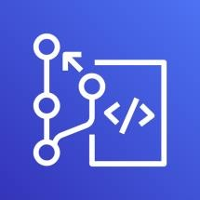


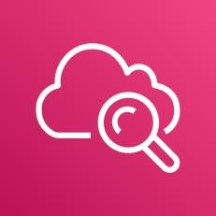

AWS Developer Tools or Code Services
Source
Build
Test
Deploy
Monitor
AWS CodeCommit
AWS CodeBuild
AWS CodeBuild + Third Party
CodeBuild
kubectl
AWS CloudWatch
Container Insights
AWS CodePipeline

Slide 101
AWS Developer Tools or Code Services
Source
Build
Test
Deploy
Monitor
AWS CodeCommit
AWS CodeBuild
AWS CodeBuild + Third Party
CodeBuild
kubectl
AWS CloudWatch
Container Insights
AWS CodePipeline

Slide 102

Microservices
Postman
Client
Create User API
Send Notification API
List Users API
Health Status API
Email
End User
Delete User API
Health Status API
User Management Microservice
Notification Microservice
API Developer
Or
API User
Users DB
SMTP Server

Slide 103

Microservices Deployment on AWS EKS
Users
https://ums.kubeoncloud.com/usermgmt/user
AWS Cloud
ums.kubeoncloud.com
services.kubeoncloud.com
EKS Cluster
VPC
Amazon Route 53
Availability Zone: us-east-1a
Availability Zone: us-east-1a
Public subnet
Public subnet
Ingress
Application Load Balancer
AWS Certificate
Manager
UMS – Ingress Service
NAT gateway
NAT gateway
Private subnet
Private subnet
End User
EC2 Worker Node-1
UMS – NodePort Service
EC2 Worker Node-2
Usermgmt Microservice Deployment
U
U
UMS Pod
UMS Pod
MySQL – External Name Service
Email
Notification – ClusterIP Service
Notification Microservice Deployment
N
N
Amazon RDS DB
NS Pod
NS Pod
Amazon RDS DB
SMTP – External Name Service
Simple Email
Service (SES)
EKS Managed Node Groups

Slide 104
Kubernetes – DaemonSets
UMS LoadBalancer Service
U
U
ReplicaSet
U
U
AWS X-Ray
UMS POD
UMS POD
UMS POD
UMS POD
UMS Deployment
XRay ClusterIP Service
X
DaemonSet
X
XRay pod
XRay pod
Worker Node - 1
Worker Node - 2
Kubernetes Cluster

Slide 105
Microservices Distributed Tracing with AWS X-Ray
Users
AWS Cloud
https:// xraydemo.kubeoncloud.com/usermgmt/notification-xray
xraydemo.kubeoncloud.com
services-xray.kubeoncloud.com
VPC
Amazon Route 53
End User
Availability Zone: us-east-1a
Public subnet
Private subnet
EC2 Worker Node-1
Ingress
Application Load Balancer
UMS – NodePort Service
AWS Certificate
Manager
Email
UMS – Ingress Service
U
Amazon RDS DB
UMS Pod
UMS Deployment
MySQL – External Name Service
Notification – ClusterIP Service
Simple Email
Service (SES)
N
NS Pod
NS Deployment
NAT gateway
SMTP – External Name Service
EKS Cluster
X-Ray – ClusterIP Service
X
X-Ray Pod
XRay DaemonSet
EKS Managed Node Groups
AWS X-Ray

Slide 106
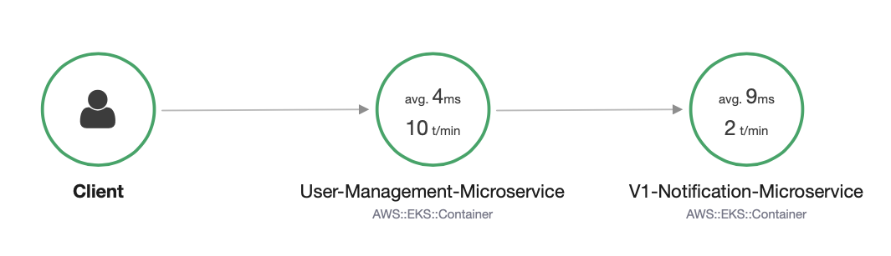
AWS X-Ray – Service Map

Slide 107
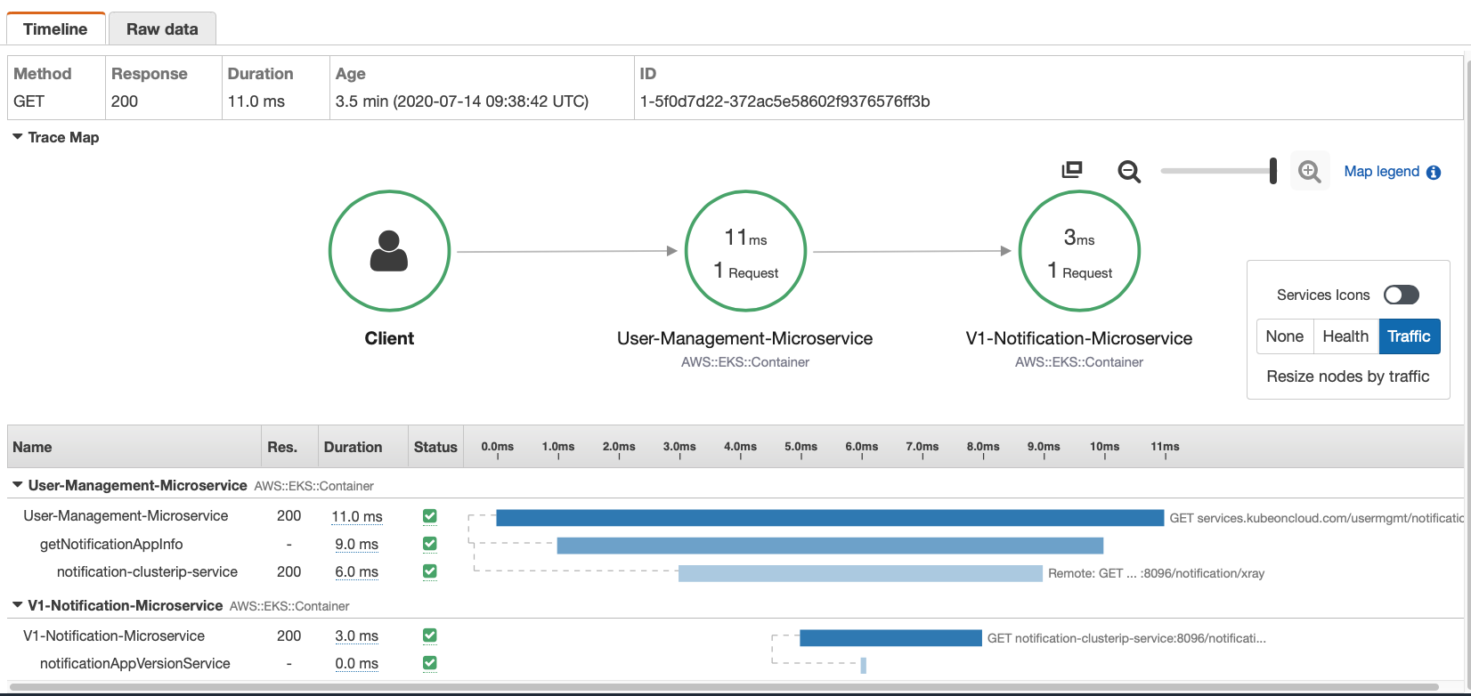
AWS X-Ray - Traces

Slide 108
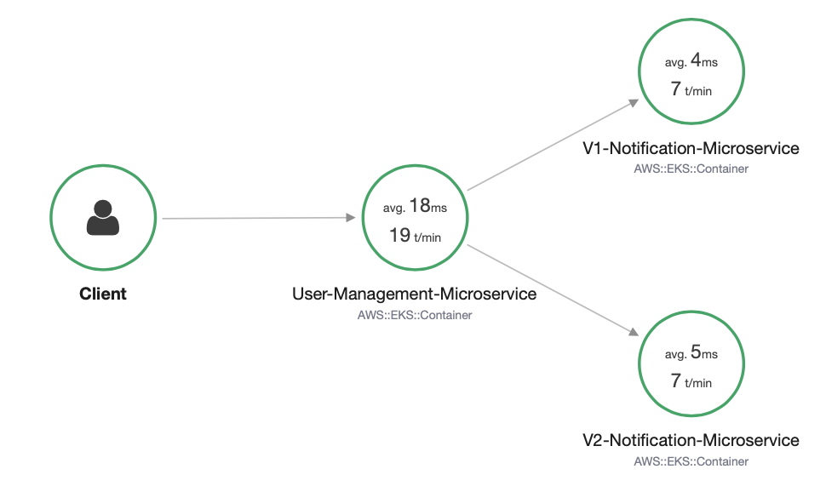
Microservices – Canary Deployments

Slide 109
How HPA works?
Metrics Server
Pod - 1
Pod - 2
Pod - N
2. Calculate the Replica’s
.
.
.
This control loop is executed every 15 seconds
15 secs
Horizontal Pod Autoscaler
1. Query for Metrics
Deployment
ReplicaSet
3. Scale the app to desired replicas
Scale
Replication Controller
StatefulSet
Application
Kubernetes Cluster

Slide 110
Container Insights
Container Map
Container Resources
Load Balancer Service
Performance Dashboards
Log Groups
Log Insights
Alarms
N
N
ReplicaSet
App Pod
App pod
NGINX Deployment
Developer or Operations User
C
CloudWatch Agent
DaemonSet
C
CW pod
CW pod
CloudWatch
Fluentd
DaemonSet
F
F
Fluentd pod
Fluentd pod
Worker Node - 1
Worker Node - 2
Kubernetes Cluster

Slide 111

CloudWatch Container Insights Map

Slide 112
AWS EKS
Cluster

Slide 113
AWS EKS – Core Objects
EKS Cluster
EKS Control Plane
Worker Nodes & Node Groups
Fargate Profiles
(Serverless)
VPC
Contains Kubernetes Master components like etcd, kube-apiserver, kube-controller.
It’s a managed service by AWS
Group of EC2 Instances where we run our Application workloads
Instead of EC2 Instances, we run our Application workloads on Serverless Fargate profiles
With AWS VPC we follow secure networking standards which will allow us to run production workloads on EKS.

Slide 114

How does EKS work?
© Amazon

Slide 115
EKS Cluster – Core Objects Detailed
EKS Control Plane
EKS runs a single tenant Kubernetes control plane for each cluster, and control plane infrastructure is not shared across clusters or AWS accounts.
This control plane consists of at least two API server nodes and three etcd nodes that run across three Availability Zones within a Region
EKS automatically detects and replaces unhealthy control plane instances, restarting them across the Availability Zones within the Region as needed.
Worker Nodes
&
Node Groups
Worker machines in Kubernetes are called nodes. These are EC2 Instances
EKS worker nodes run in our AWS account and connect to our cluster's control plane via the cluster API server endpoint.
A node group is one or more EC2 instances that are deployed in an EC2 Autoscaling group.
All instances in a node group must
Be the same instance type
Be running the same AMI
Use the same EKS worker node IAM role

Slide 116
EKS Cluster – Core Objects Detailed
Fargate Profiles
AWS Fargate is a technology that provides on-demand, right-sized compute capacity for containers
With Fargate, we no longer have to provision, configure, or scale groups of virtual machines to run containers.
Each pod running on Fargate has its own isolation boundary and does not share the underlying kernel, CPU resources, memory resources, or elastic network interface with another pod.
AWS specially built Fargate controllers that recognizes the pods belonging to fargate and schedules them on Fargate profiles.
We will see more in our Fargate learning section.
VPC
EKS uses AWS VPC network policies to restrict traffic between control plane components to within a single cluster.
Control plane components for a EKS cluster cannot view or receive communication from other clusters or other AWS accounts, except as authorized with Kubernetes RBAC policies.
This secure and highly-available configuration makes EKS reliable and recommended for production workloads.

Slide 117
AWS EKS
Storage

Slide 118
EKS Storage
In-Tree EBS Provisioner
EBS CSI Driver
EFS CSI Driver
FSx for Luster CSI
Legacy
CSI means Container Storage Interface
Will be deprecated soon
Latest & Greatest available today & in Beta release & ready for production use
As on today, not supported on AWS EKS Fargate (Serverless)
Allows EKS Clusters to manage lifecycle of EBS Volumes for persistent storage, EFS File systems & FSx for Luster File systems
Supported for k8s 1.14 & later
Supported for k8s 1.16 & later

Slide 119
AWS EKS Storage
EBS CSI Driver

Slide 120
AWS Elastic Block Store - Introduction
EBS provides block level storage volumes for use with EC2 & Container instances.
We can mount these volumes as devices on our EC2 & Container instances.
EBS volumes that are attached to an instance are exposed as storage volumes that persist independently from the life of the EC2 or Container instance.
We can dynamically change the configuration of a volume attached to an instance.
AWS recommends EBS for data that must be quickly accessible and requires long-term persistence.
EBS is well suited to both database-style applications that rely on random reads and writes, and to throughput-intensive applications that perform long, continuous reads and writes.

Slide 121
EKS Storage EBS CSI Driver
EKS Cluster
MySQL – ClusterIP Service
AWS Elastic Block Store - EBS
Storage Class
Environment Variables
Persistent Volume Claim
Volumes
MySql
Config Map
Volume Mounts
POD
ReplicaSet
Deployment
Deployment (mysql)
ClusterIP Service

Slide 122
EKS Cluster
http://<workernode-public-ip>:<NodePort>/usermgmt/<apis>
UserMgmt – NodePort Service
Users
NodePort Service
REST API
Deployment
EKS Storage EBS CSI Driver
POD
Environment Variables
ReplicaSet
Deployment (UserMgmt)
MySQL – ClusterIP Service
AWS Elastic Block Store - EBS
Storage Class
Environment Variables
Persistent Volume Claim
Volumes
MySql
Config Map
Volume Mounts
POD
ReplicaSet
Deployment
Deployment (mysql)
ClusterIP Service

Slide 123
Elastic Block Store
AWS EKS Storage
EBS CSI Driver
Important k8s Concepts
for Application Deployments

Slide 124
EKS Cluster
http://<workernode-public-ip>:<NodePort>/usermgmt/<apis>
UserMgmt – NodePort Service
Secrets
Namespaces
Users
Init Containers
NodePort Service
Liveness & Readiness Probes
REST API
Deployment
EKS Storage EBS CSI Driver
Requests & Limits
POD
Environment Variables
ReplicaSet
Deployment (UserMgmt)
MySQL – ClusterIP Service
AWS Elastic Block Store - EBS
Storage Class
Environment Variables
Persistent Volume Claim
Volumes
MySql
Config Map
Volume Mounts
POD
ReplicaSet
Deployment
Deployment (mysql)
ClusterIP Service

Slide 125
Probes
Probes
Liveness Probe
Readiness Probe
Startup Probe
Kubelet uses liveness probes to know when to restart a container
Kubelet uses readiness probes to know when a container is ready to accept traffic
Kubelet uses startup probes to know when a container application has started
Liveness probes could catch a deadlock, where an application is running, but unable to make progress and restarting container helps in such state
When a Pod is not ready, it is removed from Service load balancers based on this readiness probe signal.
Firstly this proble disables liveness & readiness checks until it succeeds ensuring those pods don’t interfere with app startup.
This can be used to adopt liveness checks on slow starting containers, avoiding them getting killed by the kubelet before they are up and running.
Options to define Probes
Check using Commands
/bin/sh –c nc -z localhost 8095
Check using HTTP GET Request
httpget path:/health-status
Check using TCP
tcpSocket Port: 8095

Slide 126
Kubernetes
Namespaces

Slide 127

Namespaces - Introduction
Namespaces are also called Virtual clusters in our physical k8s cluster
We use this in environments where we have many users spread across multiple teams or projects
Clusters with tens of users ideally don’t need to use namespaces
Benefits
Creates isolation boundary from other k8s objects
We can limit the resources like CPU, Memory on per namespace basis (Resource Quota).

Slide 128

Namespaces
LoadBalancer Service
LoadBalancer Service
LoadBalancer Service
F
F
F
Pod
Pod
Pod
Namespace Manifest - Declarative
ReplicaSet
ReplicaSet
ReplicaSet
Deployment
Deployment
Deployment
ClusterIP Service
ClusterIP Service
ClusterIP Service
B
B
B
Pod
Pod
Pod
ReplicaSet
ReplicaSet
ReplicaSet
Deployment
Deployment
Deployment
Namespace: dev
Namespace: qa
Namespace: staging
Namespace Manifest - Imperative
Deployment

Slide 129

Limit Range
LoadBalancer Service
LoadBalancer Service
LoadBalancer Service
F
F
F
Pod
Pod
Pod
Limit Range Manifest
ReplicaSet
ReplicaSet
ReplicaSet
Deployment
Deployment
Deployment
ClusterIP Service
ClusterIP Service
ClusterIP Service
B
B
B
Pod
Pod
Pod
ReplicaSet
ReplicaSet
ReplicaSet
Deployment
Deployment
Deployment
Deployment
CPU
Memory
CPU
Memory
CPU
Memory
default
Min/Max
default
Min/Max
default
Min/Max
Limit Range (Per Container)
Limit Range (Per Container)
Limit Range (Per Container)
Namespace: dev
Namespace: qa
Namespace: staging

Slide 130

Resource Quota
LoadBalancer Service
LoadBalancer Service
LoadBalancer Service
F
F
F
Resource Quota Manifest
Pod
Pod
Pod
ReplicaSet
ReplicaSet
ReplicaSet
Deployment
Deployment
Deployment
ClusterIP Service
ClusterIP Service
ClusterIP Service
B
B
B
Pod
Pod
Pod
ReplicaSet
ReplicaSet
ReplicaSet
Deployment
Deployment
Deployment
Deployment
CPU
Memory
CPU
Memory
CPU
Memory
Pods
Services
Pods
Services
Pods
Services
Resource Quota
Resource Quota
Resource Quota
Namespace: dev
Namespace: qa
Namespace: staging

Slide 131
Amazon RDS
AWS EKS
&
RDS Database

Slide 132
EKS Cluster
http://<workernode-public-ip>:<NodePort>/usermgmt/<apis>
UserMgmt – NodePort Service
Users
NodePort Service
EKS Storage EBS CSI Driver
REST API
Deployment
POD
Environment Variables
ReplicaSet
Drawbacks of EBS CSI for MySQL DB
Deployment (UserMgmt)
Complex setup to achieve HA
MySQL – ClusterIP Service
StatefulSets
AWS Elastic Block Store - EBS
Complex Multi-Az support for EBS
Storage Class
Environment Variables
Complex Master-Master MySQL setup
Persistent Volume Claim
Volumes
Complex Master-Slave MySQL setup
MySql
No Automatic Backup & Recovery
Config Map
Volume Mounts
POD
No Auto-Upgrade MySQL
ReplicaSet
Deployment
Deployment (mysql)
ClusterIP Service

Slide 133
http://<workernode-public-ip>:<NodePort>/usermgmt/<apis>
EKS Cluster
UserMgmt – NodePort Service
Users
NoePort Service
REST API
Deployment
AWS
RDS Database
POD
Environment Variables
ReplicaSet
Deployment (UserMgmt)
ExternalName Service
MySQL – ExternalName Service
High Availability
Metrics & Monitoring
Backup & Recovery
Automatic Upgrades
Read Replicas
Amazon RDS
Multi-AZ Support

Slide 134
AWS Cloud
EKS Cluster Control Plane
VPC
Availability Zone: us-east-1a
Availability Zone: us-east-1b
Public subnet
Public subnet
http://<workernode-public-ip>:<NodePort>/usermgmt/<apis>
EC2 Worker Node-1
EC2 Worker Node-2
User Management – Node Port Service
Users
U
U
ReplicaSet
U
U
Pod
Pod
Pod
Pod
Deployment
MySQL – External Name Service
Private subnet
Private subnet
AWS EKS
Network Design
With
EKS Workload
&
RDS Database
Amazon RDS
Amazon RDS

Slide 135
Classic
Load Balancer
Network
Load Balancer
Application
Load Balancer
AWS
Elastic Load Balancing
Overview

Slide 136
Elastic Load Balancing
Classic Load Balancer
Network Load Balancer
Application Load Balancer
https://aws.amazon.com/elasticloadbalancing/features/#compare

Slide 137
Elastic Load
Balancing
Classic
Load Balancer
Network
Load Balancer
Application
Load Balancer
Amazon RDS
AWS EKS
&
RDS & ELB
Classic Load Balancer

Slide 138
AWS Cloud
EKS Cluster Control Plane
VPC
Availability Zone: us-east-1a
Availability Zone: us-east-1b
Public subnet
Public subnet
http://<workernode-public-ip>:<NodePort>/usermgmt/<apis>
EC2 Worker Node-1
EC2 Worker Node-2
User Management – Node Port Service
Users
U
U
ReplicaSet
U
U
Pod
Pod
Pod
Pod
Deployment
MySQL – External Name Service
Private subnet
Private subnet
AWS EKS
Network Design
With
EKS Workload
&
RDS Database
Amazon RDS
Amazon RDS

Slide 139
AWS Cloud
VPC
EKS Cluster Control Plane
Availability Zone: us-east-1a
Availability Zone: us-east-1b
Users
Public subnet
Public subnet
Classic CLB DNS URL
Classic Load Balancer
User Management – Classic Load Balancer Service
NAT gateway
NAT gateway
Private subnet
Private subnet
EC2 Worker Node-1
EC2 Worker Node-2
U
U
ReplicaSet
U
U
Pod
Pod
Pod
Pod
Deployment
MySQL – External Name Service
AWS EKS
Network Design
With
EKS Workload
RDS & ELB
Classic Load Balancer
EKS Private NodeGroup
Amazon RDS DB
Amazon RDS DB

Slide 140
Elastic Load
Balancing
Classic
Load Balancer
Network
Load Balancer
Application
Load Balancer
Amazon RDS
AWS EKS
&
RDS & ELB
Network Load Balancer

Slide 141
AWS Cloud
VPC
EKS Cluster Control Plane
Availability Zone: us-east-1a
Availability Zone: us-east-1b
Users
Public subnet
Public subnet
NLB DNS URL
Network Load Balancer
User Management – Network Load Balancer Service
NAT gateway
NAT gateway
Private subnet
Private subnet
EC2 Worker Node-1
EC2 Worker Node-2
U
U
ReplicaSet
U
U
Pod
Pod
Pod
Pod
Deployment
MySQL – External Name Service
AWS EKS
Network Design
With
EKS Workload
RDS & ELB
Network Load Balancer
EKS Private NodeGroup
Amazon RDS DB
Amazon RDS DB

Slide 142
Elastic Load
Balancing
Classic
Load Balancer
Network
Load Balancer
Application
Load Balancer
Amazon RDS
AWS EKS
&
RDS & ELB
Application Load Balancer

Slide 143

How Ingress Works?

Slide 144



k8s ClusterRole
k8s ServiceAccount
k8s ClusterRoleBinding
AWS IAM Policy
https://raw.githubusercontent.com/kubernetes-sigs/aws-alb-ingress-controller/master/docs/examples/iam-policy.json

Slide 145
AWS Cloud
VPC
EKS Cluster Control Plane
Availability Zone: us-east-1a
Availability Zone: us-east-1b
Users
Amazon Route 53
Public subnet
Public subnet
SSL
Application Load Balancer
HTTP → HTTPS
SSL Redirect
external-dns
User Management – Application Load Balancer Service (Ingress)
apps.kubeoncloud.com
NAT gateway
NAT gateway
/app1/*
/app2/*
Ingress
/*
HTTPS URLS
https://apps.kubeoncloud.com/usermgmt/users
Private subnet
Private subnet
EC2 Worker Node-1
EC2 Worker Node-2
app1- NodePort SVC
app2 -NodePort SVC
User Management – Node Port Service
N
N
U
AWS Certificate Manager
Pod
Pod
Pod
ReplicaSet
ReplicaSet
ReplicaSet
Deployment: app1
Deployment: app2
Deployment: UMS
MySQL – External Name Service
AWS EKS
Network Design
With
EKS Workload
RDS & ELB
Application
Load Balancer & Route53
Ingress & External-DNS
EKS Private NodeGroup
Amazon RDS DB
Amazon RDS DB

Slide 146
Elastic Load
Balancing
Classic
Load Balancer
Network
Load Balancer
Application
Load Balancer
Amazon RDS
AWS EKS
RDS & ELB
Application Load Balancer
Ingress Controller Basics

Slide 147
AWS Cloud
VPC
EKS Cluster Control Plane
Availability Zone: us-east-1a
Availability Zone: us-east-1b
Users
Public subnet
Public subnet
http://ALB-DNS-URL/usermgmt/users
Application Load Balancer
User Management – Application Load Balancer Service (Ingress)
NAT gateway
/*
NAT gateway
Ingress
Private subnet
Private subnet
EC2 Worker Node-1
EC2 Worker Node-2
User Management – Node Port Service
U
Pod
ReplicaSet
Deployment: UMS
AWS EKS
Network Design
With
EKS Workload
RDS & ELB
Application
Load Balancer
MySQL – External Name Service
EKS Private NodeGroup
Amazon RDS DB
Amazon RDS DB

Slide 148
Elastic Load
Balancing
Classic
Load Balancer
Network
Load Balancer
Application
Load Balancer
Amazon RDS
AWS EKS
RDS & ELB
Application Load Balancer
Ingress Context Path based Routing

Slide 149
AWS Cloud
VPC
EKS Cluster Control Plane
Availability Zone: us-east-1a
Availability Zone: us-east-1b
Users
Public subnet
Public subnet
http://ALB-DNS-URL/usermgmt/users
Application Load Balancer
http://ALB-DNS-URL/app1/index.html
http://ALB-DNS-URL/app2/index.html
User Management – Application Load Balancer Service (Ingress)
NAT gateway
/app1/*
/app2/*
/*
NAT gateway
Ingress
Private subnet
Private subnet
EC2 Worker Node-1
EC2 Worker Node-2
app1- NodePort SVC
app2 -NodePort SVC
User Management – Node Port Service
N
N
U
Pod
Pod
Pod
ReplicaSet
ReplicaSet
ReplicaSet
Deployment: app1
Deployment: app2
Deployment: UMS
AWS EKS
Network Design
With
EKS Workload
RDS & ELB
Application
Load Balancer
Context path based Routing
MySQL – External Name Service
EKS Private NodeGroup
Amazon RDS DB
Amazon RDS DB

Slide 150
Elastic Load
Balancing
Classic
Load Balancer
Network
Load Balancer
Application
Load Balancer
Amazon RDS
AWS EKS
RDS & ELB
Application Load Balancer
Ingress SSL

Slide 151
AWS Cloud
VPC
EKS Cluster Control Plane
Availability Zone: us-east-1a
Availability Zone: us-east-1b
Users
Amazon Route 53
Public subnet
Public subnet
SSL
Application Load Balancer
HTTP URLS
http://ssldemo.kubeoncloud.com/usermgmt/users http://ssldemo.kubeoncloud.com/app1/index.html http://ssldemo.kubeoncloud.com/app2/index.html
User Management – Application Load Balancer Service (Ingress)
NAT gateway
/app1/*
/app2/*
/*
NAT gateway
Ingress
Private subnet
Private subnet
HTTPS URLS
https://ssldemo.kubeoncloud.com/usermgmt/users https://ssldemo.kubeoncloud.com/app1/index.html https://ssldemo.kubeoncloud.com/app2/index.html
EC2 Worker Node-1
EC2 Worker Node-2
app1- NodePort SVC
app2 -NodePort SVC
User Management – Node Port Service
N
N
U
AWS Certificate Manager
Pod
Pod
Pod
ReplicaSet
ReplicaSet
ReplicaSet
Deployment: app1
Deployment: app2
Deployment: UMS
AWS EKS
Network Design
With
EKS Workload
RDS & ELB
Application
Load Balancer
Ingress SSL
MySQL – External Name Service
EKS Private NodeGroup
Amazon RDS DB
Amazon RDS DB

Slide 152
Elastic Load
Balancing
Classic
Load Balancer
Network
Load Balancer
Application
Load Balancer
Amazon RDS
AWS EKS
RDS & ELB
Application Load Balancer
Ingress SSL Redirect

Slide 153
AWS Cloud
VPC
EKS Cluster Control Plane
Availability Zone: us-east-1a
Availability Zone: us-east-1b
Users
Amazon Route 53
Public subnet
Public subnet
SSL
Application Load Balancer
HTTP → HTTPS
SSL Redirect
User Management – Application Load Balancer Service (Ingress)
HTTPS URLS
https://ssldemo.kubeoncloud.com/usermgmt/users https://ssldemo.kubeoncloud.com/app1/index.html https://ssldemo.kubeoncloud.com/app2/index.html
NAT gateway
NAT gateway
/app1/*
/app2/*
Ingress
/*
Private subnet
Private subnet
EC2 Worker Node-1
EC2 Worker Node-2
app1- NodePort SVC
app2 -NodePort SVC
User Management – Node Port Service
N
N
U
AWS Certificate Manager
Pod
Pod
Pod
ReplicaSet
ReplicaSet
ReplicaSet
Deployment: app1
Deployment: app2
Deployment: UMS
AWS EKS
Network Design
With
EKS Workload
RDS & ELB
Application
Load Balancer
Ingress SSL Redirect
MySQL – External Name Service
EKS Private NodeGroup
Amazon RDS DB
Amazon RDS DB

Slide 154
Elastic Load
Balancing
Classic
Load Balancer
Network
Load Balancer
Application
Load Balancer
Amazon RDS
AWS EKS
RDS & ELB
Application Load Balancer & Route53
Ingress & External-DNS

Slide 155
AWS Cloud
VPC
EKS Cluster Control Plane
Availability Zone: us-east-1a
Availability Zone: us-east-1b
Users
Amazon Route 53
Public subnet
Public subnet
SSL
Application Load Balancer
HTTP → HTTPS
SSL Redirect
external-dns
User Management – Application Load Balancer Service (Ingress)
dnstest1.kubeoncloud.com
dnstest2.kubeoncloud.com
NAT gateway
NAT gateway
/app1/*
/app2/*
Ingress
/*
HTTPS URLS
https://dnstest1.kubeoncloud.com/usermgmt/users https://dnstest1.kubeoncloud.com/app1/index.html https://dnstest1.kubeoncloud.com/app2/index.html
https://dnstest2.kubeoncloud.com/usermgmt/users https://dnstest2.kubeoncloud.com/app1/index.html https://dnstest2.kubeoncloud.com/app2/index.html
Private subnet
Private subnet
EC2 Worker Node-1
EC2 Worker Node-2
app1- NodePort SVC
app2 -NodePort SVC
User Management – Node Port Service
N
N
U
AWS Certificate Manager
Pod
Pod
Pod
ReplicaSet
ReplicaSet
ReplicaSet
Deployment: app1
Deployment: app2
Deployment: UMS
MySQL – External Name Service
AWS EKS
Network Design
With
EKS Workload
RDS & ELB
Application
Load Balancer & Route53
Ingress & External-DNS
EKS Private NodeGroup
Amazon RDS DB
Amazon RDS DB

Slide 156
Elastic Load
Balancing
Classic
Load Balancer
Network
Load Balancer
Application
Load Balancer
Certificate
Manager
Route53
Elastic Block
Store
Amazon RDS
AWS EKS
Fargate Profiles
Serverless
Fargate
Profiles

Slide 157
What is Fargate?
Fargate is a Serverless compute platform for containers on AWS
Fargate provides on-demand, right-sized compute capacity for containers
EKS integrates Kubernetes with Fargate by using controllers that are built by AWS using the upstream, extensible model provided by Kubernetes.
These controllers run as part of the EKS managed Kubernetes control plane and are responsible for scheduling native Kubernetes pods onto Fargate.
The Fargate controllers include a new scheduler that runs alongside the default Kubernetes scheduler in addition to several mutating and validating admission controllers.
When we start a pod that meets the criteria for running on Fargate, the Fargate controllers running in the cluster recognize, update, and schedule the pod onto Fargate.

Slide 158
AWS EKS on Fargate
=
Bring existing pods
Production Ready
Rightsized and Integrated
We don’t need to change our existing pods
Fargate works with existing workflows and services that run on kubernetes
Launch pods easily.
Easily run pods across Azs for HA
Each pod runs in an isolated compute environment
Only pay for resources you need to run your pods
Includes native AWS integrations for networking and security

Slide 159
EKS Deployment Options
Managed EC2 Nodes
Only EC2 Node Groups
Unmanaged EC2 Nodes
Managed Nodes
EKS Deployment Options
Mixed
Unmanaged EC2 Nodes
Fargate Nodes
Only Fargate
Fargate Nodes

Slide 160
EKS Deployment Options – EC2 Node Groups
AWS Cloud
EKS Cluster
VPC
Availability Zone: us-east-1a
Availability Zone: us-east-1b
Public subnet
Public subnet
Auto Scaling group
We can deploy EC2 Managed Node Groups in both public and private subnets of a VPC
EC2 Instance
EKS Public Managed Node Group
EC 2Instance
Private subnet
Private subnet
Auto Scaling group
EC2 Instance
EKS Private Managed Node Group
EC 2Instance
EKS Managed Node Groups

Slide 161
EKS Deployment Options – Only Fargate
EKS Cluster
AWS Cloud
VPC
Availability Zone: us-east-1a
Availability Zone: us-east-1b
Public subnet
Public subnet
Pods running on Fargate are only supported on private subnets
Private subnet
EKS Fargate
Private subnet
Fargate Profile
Fargate EC2 Instance
Fargate EC2 Instance
EKS Fargate Profiles

Slide 162
EKS Deployment Options - Mixed
EKS Cluster
AWS Cloud
VPC
Availability Zone: us-east-1a
Availability Zone: us-east-1b
Availability Zone: us-east-1a
Availability Zone: us-east-1b
Public subnet
Public subnet
Public subnet
Public subnet
Auto Scaling group
EC2 Instance
EKS Public Managed Node Group
EC 2Instance
Private subnet
Private subnet
Private subnet
EKS Fargate
Private subnet
Auto Scaling group
Fargate Profile
EC2 Instance
EKS Private Managed Node Group
EC 2Instance
Fargate EC2 Instance
Fargate EC2 Instance
EKS Managed Node Groups
EKS Fargate Profiles

Slide 163

EKS Fargate vs Managed vs Unmanaged Nodes

Slide 164
EKS Fargate Considerations
There are many considerations we need to be aware of before we decide our Kubernetes workloads to run on Fargate.
Documentation Link
https://docs.aws.amazon.com/eks/latest/userguide/fargate.html

Slide 165
Elastic Load
Balancing
Classic
Load Balancer
Network
Load Balancer
Application
Load Balancer
Certificate
Manager
Route53
Elastic Block
Store
Amazon RDS
AWS EKS
Fargate Profiles
Basics
Fargate
Profiles

Slide 166
EKS Deployment Options - Mixed
EKS Cluster
AWS Cloud
VPC
Availability Zone: us-east-1a
Availability Zone: us-east-1b
Public subnet
Public subnet
Auto Scaling group
EC2 Instance
EKS Public Managed Node Group
EC 2Instance
Private subnet
Private subnet
EKS Fargate
Auto Scaling group
EC2 Instance
EKS Private Managed Node Group
EC 2Instance
EKS Managed Node Groups
EKS Fargate Profiles

Slide 167

EKS Deployment Options - Mixed
Fargate Profiles can be deployed to EKS Cluster only when we have at least one private subnet
EKS Cluster
AWS Cloud
VPC
Availability Zone: us-east-1a
Availability Zone: us-east-1b
Availability Zone: us-east-1a
Availability Zone: us-east-1b
Public subnet
Public subnet
Public subnet
Public subnet
Auto Scaling group
EC2 Instance
EKS Public Managed Node Group
EC 2Instance
Private subnet
Private subnet
Private subnet
EKS Fargate
Private subnet
Auto Scaling group
Fargate Profile
EC2 Instance
EKS Private Managed Node Group
EC2 Instance
Fargate EC2 Instance
Fargate EC2 Instance
EKS Managed Node Groups
EKS Fargate Profiles

Slide 168
AWS Cloud
EKS Cluster Control Plane
VPC
Availability Zone: us-east-1a
Availability Zone: us-east-1b
Users
Amazon Route 53
Public subnet
Public subnet
SSL
Application Load Balancer
SSL Redirect
external-dns
fpdev.kubeoncloud.com
User Management – Application Load Balancer Service (Ingress)
https://fpdev.kubeoncloud.com/app1/index.html
NAT gateway
/*
NAT gateway
Ingress
Private subnet
Private subnet
Fargate Node-1
Fargate Node-2
N
ReplicaSet
N
AWS Certificate Manager
Pod
Pod
Deployment: app1
app1- NodePort Service
AWS EKS
Fargate Profiles
Basics
Fargate Profile: fp-dev

Slide 169
Elastic Load
Balancing
Classic
Load Balancer
Network
Load Balancer
Application
Load Balancer
Certificate
Manager
Route53
Elastic Block
Store
Amazon RDS
AWS EKS
Fargate Profiles
Advanced with YAML
Fargate
Profiles

Slide 170
EKS Deployment Options – Mixed Mode - 3 Apps
Users
AWS Cloud
app1. kubeoncloud.com
app2.kubeoncloud.com
ums.kubeoncloud,com
Amazon RDS DB
app1.kubeoncloud.com
app2.kubeoncloud.com
ums.kubeoncloud.com
Amazon Route 53
VPC
Availability Zone: us-east-1a
Availability Zone: us-east-1b
Availability Zone: us-east-1a
EKS Fargate
Availability Zone: us-east-1b
Public subnet
Public subnet
Private subnet
Private subnet
App1 - Ingress
UMS - Ingress
NS: ns-ums
MySQL – ExternalName Service
Fargate Profile: UMS
Ingress
App2 - Ingress
U
U
UMS Pod
UMS Pod
Private subnet
Private subnet
UMS - NodePort Service
NS: ns-app1
App1 - NodePort Service
NS: ns-app2
App2 - NodePort Service
Auto Scaling group
Fargate Profile: App2
N
N
N
N
App1 Pod
EKS Private Managed Node Group
App1 Pod
App2 Pod
App2 Pod
EKS Managed Node Groups
EKS Fargate Profiles
AWS Certificate Manager
EKS Cluster

Slide 171
EKS Deployment – Mixed – Ingress with Cross Namespaces
Users
app1. kubeoncloud.com
app2.kubeoncloud.com
ums.kubeoncloud,com
AWS Cloud
app1. kubeoncloud.com
app2.kubeoncloud.com
ums.kubeoncloud,com
Amazon RDS DB
Ingress with Cross Namespaces is not supported as on today
Amazon Route 53
VPC
Availability Zone: us-east-1a
Availability Zone: us-east-1b
Availability Zone: us-east-1a
EKS Fargate
Availability Zone: us-east-1b
Public subnet
Public subnet
Private subnet
Private subnet
App1 - Ingress
NS: ns-ums
MySQL – ExternalName Service
/app1/*
/ums/*
Fargate Profile: UMS
Ingress
/app2/*
U
U
UMS Pod
UMS Pod
Private subnet
Private subnet
UMS - NodePort Service
NS: ns-app1
App1 - NodePort Service
NS: ns-app2
App2 - NodePort Service
Auto Scaling group
Fargate Profile: App2
N
N
N
N
App1 Pod
EKS Private Managed Node Group
App1 Pod
App2 Pod
App2 Pod
EKS Managed Node Groups
EKS Fargate Profiles
AWS Certificate Manager
EKS Cluster

Slide 172
Elastic Load
Balancing
Classic
Load Balancer
Network
Load Balancer
Application
Load Balancer
Certificate
Manager
Route53
Elastic Block
Store
Amazon RDS
AWS EKS
ECR
Elastic Container Registry
Fargate
Profiles
Elastic Container
Registry

Slide 173
Elastic Container Registry - ECR
Elastic Container Registry (ECR) is a fully-managed Docker container registry that makes it easy for developers to store, manage, and deploy Docker container images.
ECR is integrated with Elastic Kubernetes Service (EKS), simplifying our development to production workflow.
ECR eliminates the need to operate our own container repositories or worry about scaling the underlying infrastructure.
ECR hosts our images in a highly available and scalable architecture, allowing us to reliably deploy containers for our applications.
Integration with AWS Identity and Access Management (IAM) provides resource-level control of each repository.
With Amazon ECR, there are no upfront fees or commitments. We pay only for the amount of data you store in your repositories and data transferred to the Internet.

Slide 174
Elastic Container Registry - ECR
Benefits
Full managed
Secure
Highly Available
Simplified Workflow

Slide 175


How ECR Works?
Developer
Docker Container
Push Images
Elastic Container Service - ECS
Pull Images and Run Containers
Docker Image
Docker Container
Pull Images
Elastic Container Registry - ECR
Elastic Kubernetes Service - EKS
Docker Container
On-Premise

Slide 176
EKS & ECR
Developer
Users
http://ecrdemo.kubeoncloud.com
AWS Cloud
ecrdemo.kubeoncloud.com
Push Images
EKS Cluster
Amazon Route 53
AWS Certificate Manager
VPC
Docker Image
Pull Docker Image from ECR
Availability Zone: us-east-1a
Availability Zone: us-east-1b
Public subnet
Public subnet
Ingress
Elastic Container Registry - ECR
NAT gateway
ECR Demo - ALB Ingress Service
NAT gateway
Private subnet
Private subnet
EC2 Worker Node-1
EC2 Worker Node-2
ECR Demo App - NodePort Service
N
N
Pod
Pod
EKS Private Managed Node Group

Slide 177
Elastic Load
Balancing
Classic
Load Balancer
Network
Load Balancer
Application
Load Balancer
Certificate
Manager
Route53
Elastic Block
Store
Amazon RDS
AWS EKS
&
AWS Developer Tools
Fargate
Profiles
Elastic Container
Registry
Code
Commit
Code
Build
Code
Pipeline

Slide 178
Stages in Release Process
Source
Build
Test
Production
Check-in source code
Peer review new code
Pull Request process
Compile Code & build artifacts (war ,jar, container images, Kubernetes manifest files)
Unit Tests
Integration tests with other systems.
Load Testing
UI Tests
Security Tests
Test Environments (Dev, QA and Staging)
Deployment to production environments
Monitor code in production to quickly detect errors
Deployment to production environments
Monitor code in production to quickly detect errors

Slide 179
Stages in Release Process
Source
Build
Test
Production

Slide 180
Continuous Integration
Source
Build
Test
Production
Automatically kick off a new release when new code is checked- in
Build and test code in a consistent, repeatable environment
Continually have an artifact ready for deployment

Slide 181
Continuous Delivery
Source
Build
Test
Production
Automatically deploy new changes to staging environments for testing
Deploy to production safely without affecting customers
Deliver to customers faster
Increase deployment frequency, and reduce change lead time and change failure rate

Slide 182
AWS Developer Tools or Code Services
Source
Build
Test
Deploy
Monitor
AWS CodeCommit
AWS CodeBuild
AWS CodeBuild + Third Party
CodeBuild
kubectl
AWS CloudWatch
Container Insights
AWS CodePipeline

Slide 183
AWS Developer Tools or Code Services
Source
Build
Test
Deploy
Monitor
AWS CodeCommit
AWS CodeBuild
AWS CodeBuild + Third Party
CodeBuild
kubectl
AWS CloudWatch
Container Insights
AWS CodePipeline

Slide 184

AWS CodeCommit

Slide 185
AWS CodeCommit - Introduction
Version Control Service hosted by AWS
We can privately store and manage documents, source code, and binary files
Secure & highly scalable
Supports standard functionality of Git (CodeCommit supports Git versions 1.7.9 and later.)
Uses a static user name and password in addition to standard SSH..

Slide 186








CodeCommit – Integration with AWS Services
AWS CodeStar
AWS CodeBuild
AWS CodePipeline
AWS Cloud9
AWS Amplify
AWS CloudFormation
AWS CodeCommit
Amazon Simple Notification Service
AWS Key Management Service
AWS Elastic Beanstalk
AWS CloudTrail
Amazon CloudWatch

Slide 187

CodeCommit - Steps
Developer
Local Git Repo
push
AWS Cloud
AWS CodeCommit

Slide 188
AWS CodeBuild

Slide 189
CodeBuild - Introduction
CodeBuild is a fully managed build service in the cloud.
Compiles our source code, runs unit tests, and produces artifacts that are ready to deploy.
Eliminates the need to provision, manage, and scale our own build servers.
It provides prepackaged build environments for the most popular programming languages and build tools such as Apache Maven, Gradle, and many more.
We can also customize build environments in CodeBuild to use our own build tools.
Scales automatically to meet peak build requests.

Slide 190


How to run CodeBuild?
How CodeBuild works?

Slide 191




Source
AWS CodeCommit
Amazon Simple Storage Service (S3)
GitHub
GitHub Enterprise
Bitbucket
AWS Managed Image
AWS CodeBuild
Amazon CloudWatch
Build Logs
Amazon EC2 Container Registry
Amazon Simple Notification Service
External Container Registry (Docker Hub)
Amazon Simple Storage Service (S3)
Build Notifications
Build Environment
Build Artifacts
AWS CodeBuild Architecture

Slide 192
CodeBuild - Steps
Developer
Commit code changes
Local Git Repo
push
AWS Cloud
AWS CodeCommit
AWS CodeBuild
Simple Storage
Service (S3)

Slide 193
AWS CodePipeline

Slide 194
CodePipeline - Introduction
AWS CodePipeline is a continuous delivery service to model, visualize, and automate the steps required to release your software.
Benefits
We can automate our release processes.
We can establish a consistent release process.
We can speed up delivery while improving quality.
Supports external tools integration for source, build and deploy.
View progress at a glance
View pipeline history details.

Slide 195



AWS CodePipeline Architecture
AWS CodePipeline
AWS CodeCommit
AWS CloudFormation
Amazon Elastic Container Service
AWS CodeBuild
Amazon CloudWatch
Amazon EC2 Container Registry
AWS CodeDeploy
Amazon Elastic Container Service (Blue/Green)
Simple Storage
Service (S3)
AWS Elastic Beanstalk
Jenkins
GitHub Webhooks
Simple Storage
Service (S3)
GitHub
AWS Service Catalog
Source
Build
Deploy
Monitor Source Changes

Slide 196

Continuous Delivery
©Amazon

Slide 197
AWS Cloud
CI CD Process
Developer
CloudWatch
CodePipeline
Commit code changes
Local Git Repo
push
S3
CodeCommit
CodeBuild
EKS Cluster
ECR
Worker Node-1
Worker Node -2
N
ReplicaSet
N
Pod
Pod
Deployment: app1
Elastic Kubernetes Service

Slide 198
Elastic Load
Balancing
Classic
Load Balancer
Network
Load Balancer
Application
Load Balancer
Certificate
Manager
Route53
Elastic Block
Store
Amazon RDS
AWS EKS
What are Microservices?
Fargate
Profiles
Elastic Container
Registry
Code
Commit
Code
Build
Code
Pipeline
Simple Email
Service

Slide 199
What are Microservices?
Microservices - also known as the microservice architecture - is an architectural style that structures an application as a collection of services that are
Highly maintainable and testable
Loosely coupled
Independently deployable
Organized around business capabilities
Owned by a small team

Slide 200
Microservices - Benefits
Developer independence: Small teams work in parallel and can iterate faster than large teams.
Isolation and resilience: If a component dies, you spin up another while and the rest of the application continues to function.
Scalability: Smaller components take up fewer resources and can be scaled to meet increasing demand of that component only.
Lifecycle automation: Individual components are easier to fit into continuous delivery pipelines and complex deployment scenarios not possible with monoliths.
Relationship to the business: Microservice architectures are split along business domain boundaries, increasing independence and understanding across the organization.

Slide 201
Elastic Load
Balancing
Classic
Load Balancer
Network
Load Balancer
Application
Load Balancer
Certificate
Manager
Route53
Elastic Block
Store
Amazon RDS
AWS EKS
Microservices Deployment
Fargate
Profiles
Elastic Container
Registry
Code
Commit
Code
Build
Code
Pipeline
Simple Email
Service

Slide 202
Microservices
Postman
Client
Create User API
Send Notification API
List Users API
Health Status API
Email
End User
Delete User API
Health Status API
User Management Microservice
Notification Microservice
API Developer
Or
API User
Users DB
SMTP Server

Slide 203
Microservices Deployment on AWS EKS
Users
https://ums.kubeoncloud.com/usermgmt/user
AWS Cloud
ums.kubeoncloud.com
services.kubeoncloud.com
EKS Cluster
VPC
Amazon Route 53
Availability Zone: us-east-1a
Availability Zone: us-east-1a
Public subnet
Public subnet
Ingress
Application Load Balancer
AWS Certificate
Manager
UMS – Ingress Service
NAT gateway
NAT gateway
Private subnet
Private subnet
End User
EC2 Worker Node-1
UMS – NodePort Service
EC2 Worker Node-2
Usermgmt Microservice Deployment
U
U
UMS Pod
UMS Pod
MySQL – External Name Service
Email
Notification – ClusterIP Service
Notification Microservice Deployment
N
N
Amazon RDS DB
NS Pod
NS Pod
Amazon RDS DB
SMTP – External Name Service
Simple Email
Service (SES)
EKS Managed Node Groups

Slide 204
Elastic Load
Balancing
Classic
Load Balancer
Network
Load Balancer
Application
Load Balancer
Certificate
Manager
Route53
Elastic Block
Store
Amazon RDS
AWS EKS
Microservices Distributed Tracing
AWS X-Ray
Fargate
Profiles
Elastic Container
Registry
Code
Commit
Code
Build
Code
Pipeline
Simple Email
Service
X-Ray

Slide 205
AWS X-Ray Introduction
AWS X-Ray helps analyse and debug distributed applications built using microservices architecture.
With X-Ray, we can understand how our application and its underlying services are performing to identify and troubleshoot the root cause of performance issues and errors.
X-Ray provides an end-to-end view of requests as they travel through our application and shows a map of our application’s underlying components.
We can also use X-Ray to analyse applications in development and in production, from simple three-tier applications to complex microservices applications consisting of thousands of services.

Slide 206
AWS X-Ray - Benefits
Review request behavior
Discover application issues
Improve application performance
Ready to use with AWS
Designed for a variety of applications

Slide 207

AWS X-Ray – How it works?
© Amazon

Slide 208
Kubernetes DaemonSets - Introduction
A DaemonSet ensures that all (or some) Nodes run a copy of a Pod.
As nodes are added to the cluster, Pods are added to them.
As nodes are removed from the cluster, those Pods are garbage collected.
Deleting a DaemonSet will clean up the Pods it created.
Some typical uses of a DaemonSet are:
running a logs collection daemon on every node (Example: fluentd)
running a node monitoring daemon on every node (Example: cloudwatchagent)
running an application trace collection daemon on every node (Example: AWS X-Ray)
In a simple case, one DaemonSet, covering all nodes, would be used for each type of daemon.
A more complex setup might use multiple DaemonSets for a single type of daemon, but with different flags and/or different memory and cpu requests for different hardware types

Slide 209
Kubernetes – DaemonSets
UMS LoadBalancer Service
U
U
ReplicaSet
U
U
AWS X-Ray
UMS POD
UMS POD
UMS POD
UMS POD
UMS Deployment
XRay ClusterIP Service
X
DaemonSet
X
XRay pod
XRay pod
Worker Node - 1
Worker Node - 2
Kubernetes Cluster

Slide 210
Microservices Distributed Tracing with AWS X-Ray
Users
AWS Cloud
https:// xraydemo.kubeoncloud.com/usermgmt/notification-xray
xraydemo.kubeoncloud.com
services-xray.kubeoncloud.com
VPC
Amazon Route 53
End User
Availability Zone: us-east-1a
Public subnet
Private subnet
EC2 Worker Node-1
Ingress
Application Load Balancer
UMS – NodePort Service
AWS Certificate
Manager
Email
UMS – Ingress Service
U
Amazon RDS DB
UMS Pod
UMS Deployment
MySQL – External Name Service
Notification – ClusterIP Service
Simple Email
Service (SES)
N
NS Pod
NS Deployment
NAT gateway
SMTP – External Name Service
EKS Cluster
X-Ray – ClusterIP Service
X
X-Ray Pod
XRay DaemonSet
EKS Managed Node Groups
AWS X-Ray

Slide 211
AWS X-Ray – Service Map

Slide 212
AWS X-Ray - Traces

Slide 213


AWS X-Ray - Traces

Slide 214
Elastic Load
Balancing
Classic
Load Balancer
Network
Load Balancer
Application
Load Balancer
Certificate
Manager
Route53
Elastic Block
Store
Amazon RDS
AWS EKS
Microservices
Canary Deployments
Fargate
Profiles
Elastic Container
Registry
Code
Commit
Code
Build
Code
Pipeline
Simple Email
Service
X-Ray

Slide 215
What are Canary Deployments?
Canaries means incremental rollouts
With canaries, the new version of the application is slowly deployed to the Kubernetes cluster while getting a very small amount of live traffic
In short, a subset of live users are connecting to the new version while the rest are still using the previous version
Using canaries, we can detect deployment issues very early while they effect only a small subset of users
If we encounter any issues with a canary, the production version is still present, and all traffic can simply be reverted to it.
User Management Microservice
75%
25%
100%
Notification Microservice - V1
Notification Microservice – V2

Slide 216
Microservices – Canary Deployments

Slide 217
Canary Deployments out of box on Kubernetes
Pods
Pods
Pods
Prod – 75%
Prod – 90%
Prod – 50%
Canary – 50%
Downside
We need to incrementally increase
pods based on percentage distribution
we need for canary
Canary – 25%
Canary – 10%

Slide 218
Canary Deployments on Kubernetes with AWS App Mesh
Pods
Pods
Pods
Prod – 70%
Prod – 20%
Prod – 95%
Canary – 5%
Canary – 30%
Canary – 80%

Slide 219
AWS EKS
Autoscaling
Horizontal Pod Autoscaler

Slide 220
Horizontal Pod Autoscaler – HPA - Intoduction
In a very simple note Horizontal Scaling means increasing and decreasing the number of Replicas (Pods)
HPA automatically scales the number of pods in a deployment, replication controller, or replica set, stateful set based on that resource's CPU utilization.
This can help our applications scale out to meet increased demand or scale in when resources are not needed, thus freeing up your worker nodes for other applications.
When we set a target CPU utilization percentage, the HPA scales our application in or out to try to meet that target.
HPA needs Kubernetes metrics server to verify CPU metrics of a pod.
We do not need to deploy or install the HPA on our cluster to begin scaling our applications, its out of the box available as a default Kubernetes API resource.

Slide 221
How HPA works?
Metrics Server
Pod - 1
Pod - 2
Pod - N
2. Calculate the Replica’s
.
.
.
This control loop is executed every 15 seconds
15 secs
Horizontal Pod Autoscaler
1. Query for Metrics
Deployment
ReplicaSet
3. Scale the app to desired replicas
Scale
Replication Controller
StatefulSet
Application
Kubernetes Cluster

Slide 222
How is HPA configured?
Scaling Metric: CPU Utilization
Target Value - CPU = 50%
HPA requires
Min Replicas = 2
Max Replicas = 10
kubectl autoscale deployment demo-deployment --cpu-percent=50 --min=1 --max=10

Slide 223
AWS EKS
Autoscaling
Vertical Pod Autoscaler

Slide 224
Vertical Pod Autoscaler – VPA - Introduction
VPA automatically adjusts the CPU and memory reservations for our pods to help "right size" our applications.
This adjustment can improve cluster resource utilization and free up CPU and memory for other pods.
Benefits
Cluster nodes are used efficiently, because Pods use exactly what they need.
Pods are scheduled onto nodes that have the appropriate resources available.
We don't have to run time-consuming benchmarking tasks to determine the correct values for CPU and memory requests.
Maintenance time is reduced, because the autoscaler can adjust CPU and memory requests over time without any action on your part.

Slide 225
VPA Components
VPA Admission Hook
VPA Recommender
VPA Updater
Every pod submitted to the k8s cluster goes through this webhook automatically which checks whether a VerticalPodAutoscaler object is referencing this pod or one of its parents (a ReplicaSet, a Deployment, etc.
Connects to the metrics-server in the cluster, fetches historical and current usage data (CPU and memory) for each VPA-enabled pod and generates recommendations for scaling up or down the requests and limits of these pods.
Runs every 1 minute. If a pod is not running in the calculated recommendation range, it evicts the currently running version of this pod, so it can restart and go through the VPA admission webhook which will change the CPU and memory settings for it, before it can start.

Slide 226
AWS EKS
Autoscaling
Cluster Autoscaler

Slide 227
Cluster Autoscaler - Introduction
Cluster Autoscaler is a tool that automatically adjusts the size of a Kubernetes cluster when one of the following conditions is true:
There are pods that failed to run in the cluster due to insufficient resources.
There are nodes in the cluster that have been underutilized for an extended period of time and their pods can be placed on other existing nodes.
The Cluster Autoscaler modifies our worker node groups so that they scale out when we need more resources and scale in when we have underutilized resources.

Slide 228
Elastic Load
Balancing
Classic
Load Balancer
Network
Load Balancer
Application
Load Balancer
Certificate
Manager
Route53
Elastic Block
Store
Amazon RDS
AWS EKS
CloudWatch
Container Insights
Fargate
Profiles
Elastic Container
Registry
Code
Commit
Code
Build
Code
Pipeline
Simple Email
Service
X-Ray
CloudWatch
Simple
Notification Service

Slide 229
Container Insights
A fully managed observability service for monitoring, troubleshooting and alarming on our containerized applications.
Container Insights to collect, aggregate, and summarize metrics and logs from our containerized applications and microservices.
The metrics include utilization for resources such as CPU, memory, disk, and network.
It also provides diagnostic information, such as container restart failures, to help us isolate issues and resolve them quickly.
We can also set CloudWatch alarms on metrics that Container Insights collects.
The metrics that Container Insights collects are available in CloudWatch automatic dashboards.
We can analyze and troubleshoot container performance and logs data with CloudWatch Logs Insights.

Slide 230
Container Insights
Container Map
Container Resources
Load Balancer Service
Performance Dashboards
Log Groups
Log Insights
Alarms
N
N
ReplicaSet
App Pod
App pod
NGINX Deployment
Developer or Operations User
C
CloudWatch Agent
DaemonSet
C
CW pod
CW pod
CloudWatch
Fluentd
DaemonSet
F
F
Fluentd pod
Fluentd pod
Worker Node - 1
Worker Node - 2
Kubernetes Cluster

Slide 231
CloudWatch Container Insights Map

Slide 232


Automatic Performance Dashboard

Slide 233
THANK YOU

